Slide 1
The Analytics Team SPROCKET CENTRAL PTY LTD
Data Analytics approach
EDGAR JANDI

Slide 2
Agenda
Introduction
Data Exploration
Model Development
Interpretation

Slide 3
Introduction
Sprocket Central Pty Ltd gave us a new list of 1000 potential customers with their demographics and attributes. However, these customers did not have prior transaction history with the organization.
Using the existing 3 datasets (Customer demographic, customer address and transactions) as a labelled dataset, we were to recommend which of these 1000 new customers should be targeted to drive the most value for the organization.

Slide 4
Data Exploration
Having been given the 3 datasets (Customer demographic, customer address and transactions), I used excel to view, clean and sort the most relevant data.
I used Python and SQL to check on the validity of the datasets after cleaning and also getting a brief view of the statistical summaries of the data.
I used Excel pivot tables and visualization tools to prove my findings.

Slide 5
Model Development
I tried using the Decision Tree and the Random Forest models but hit a dead end because the data lacked sufficient relevancy for the models and so we resorted to use Excel data models and visualizations.
Here are some summaries and visualizations.

Slide 6
Bicycle brands

Slide 7
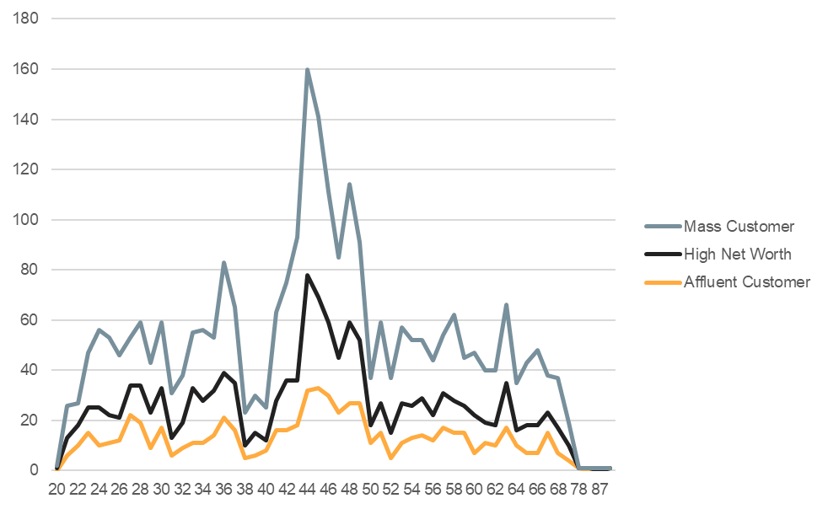
Customer demographics(age, gender and wealth segmentation)

Slide 8
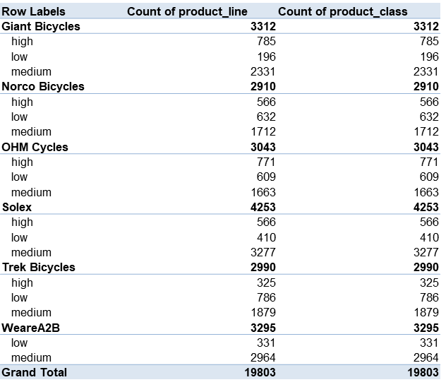
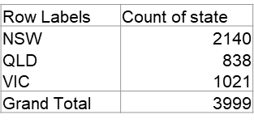

Slide 9
Interpretation
All the 6 bicycle brands are popular but Solex brand is leading with a small margin apart from the rest.
New South Wales(NSW) state has the largest number of bicycle customers with the most purchases at 2140, followed by Victoria state and Queensland(838).
Looking at the wealth segmentation, the mass customer had the most purchases followed by the High net worth group and lastly the Affluent customer.
The most common age group that purchased bicycles was age group 40-50 years across all wealth-segments.

Slide 10
Recommendations
The company should target selling all the 6 bicycle brands in New South Wales State to the 30-50 age group who are majorly Mass customers and High net worth individuals. That is where their bicycles are popular.

Slide 11
THE END.

